Slide 1
Boone Lennon
‘Problem solution’

Slide 2
General information
Boone’s General information
Dob: 1949
Residency: Bozeman Montana USA
Interests: skiing, snowboarding, cycling, coaching skiing, problem solving

Slide 3
Background
Boone Lennon's sporting background
Skied since he was three making 53 years to this year
Boone did not really interact with the concept of racing in skiing
Boone also cycled and raced in that sport from time to time during and before his inventions
In 1978 he was elected by his skiing community to be the KOM of sun valley Idaho in response to skiing magazine
Using his background he coached 9 years in sun valley before coaching the national and world cup teams 1984-1986

Slide 4
How Boone got into the design world
Through his knowledge of aerodynamics from downhill skiing to design his aerodynamic handlebars
Boone designed his designs through his idea and philosophy of Problem Solution

Slide 5
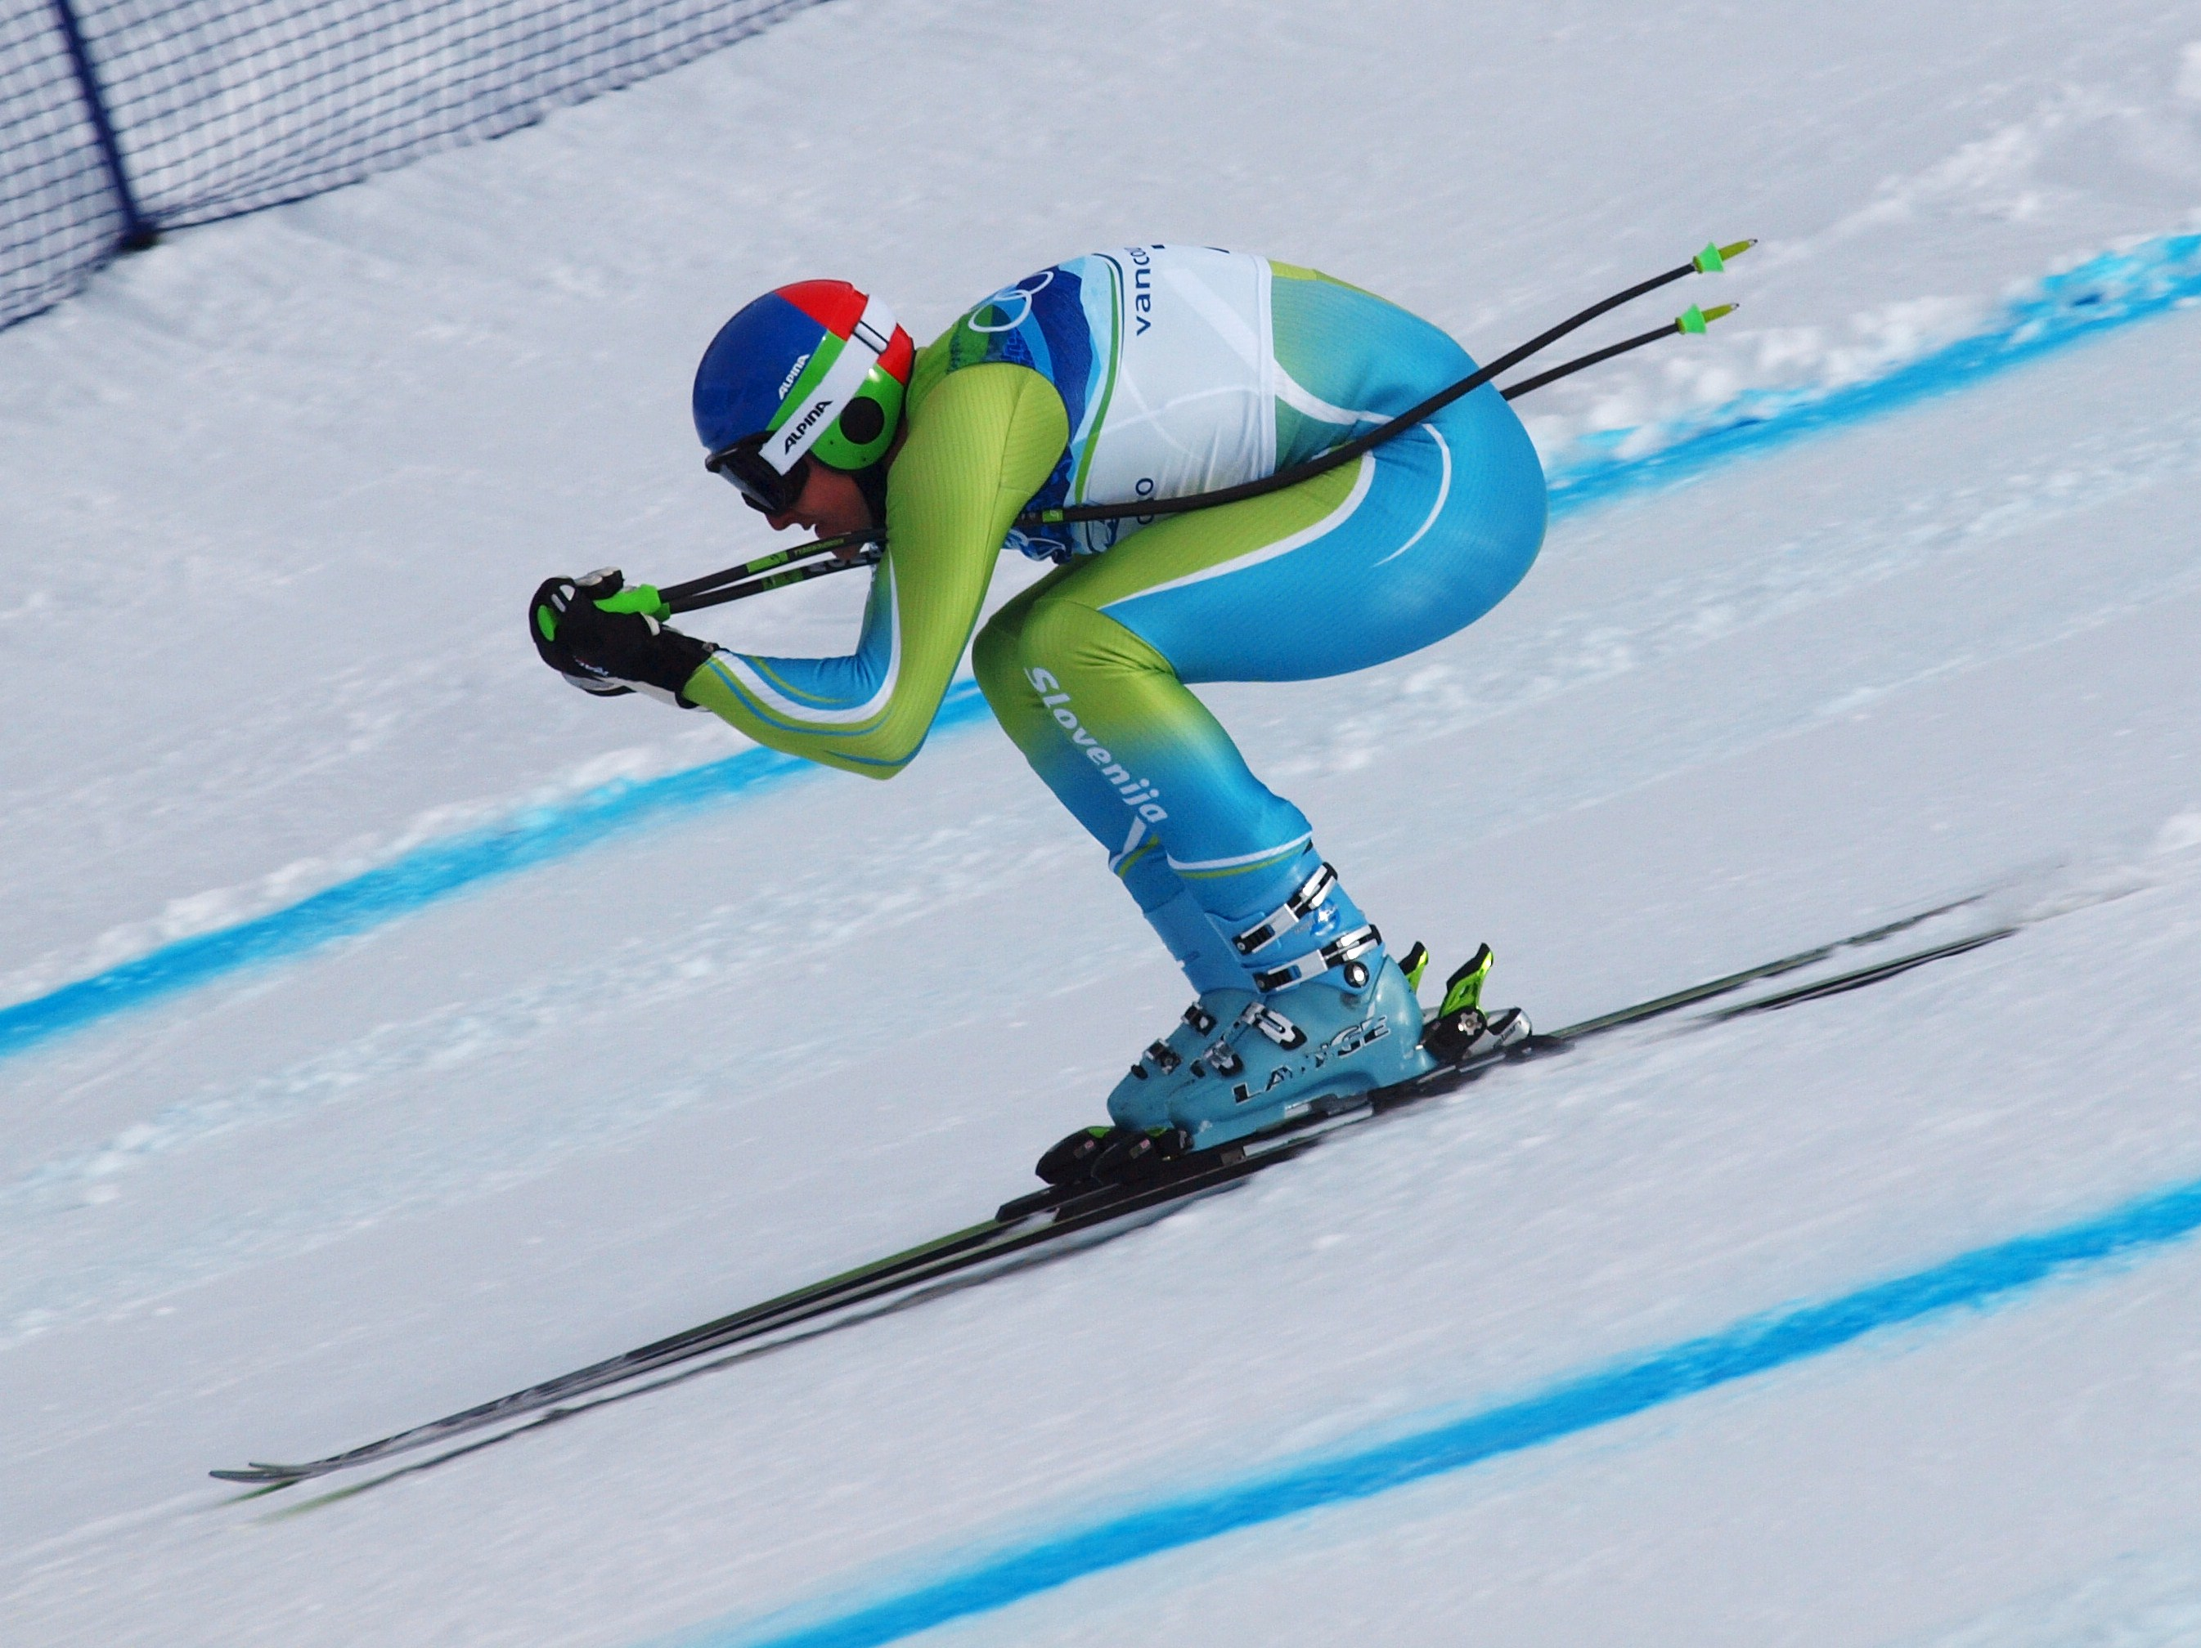
Down hill skier

Slide 6
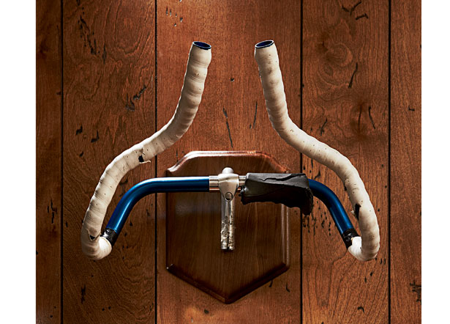
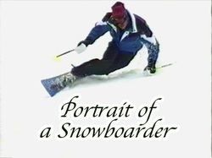
Key Designs

Slide 7
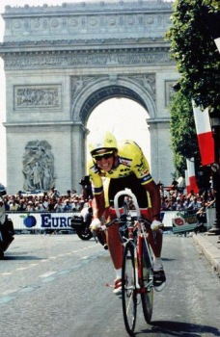
Some Results
In 1989 Greg Lemond used these bars in the tour de France on his time trial bars which led to winning the tour.
In just six years all world records have been broken with the use of the bars.
Today you will not win a world championship event without them.

Slide 8
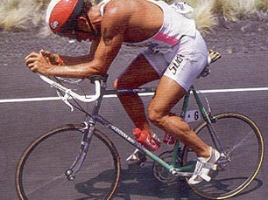
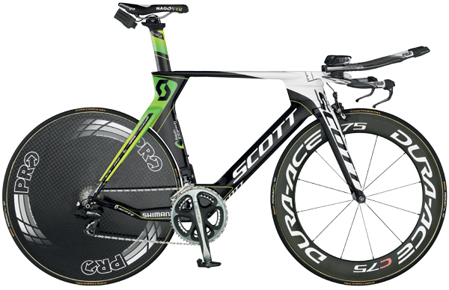
Design revolution

Slide 9
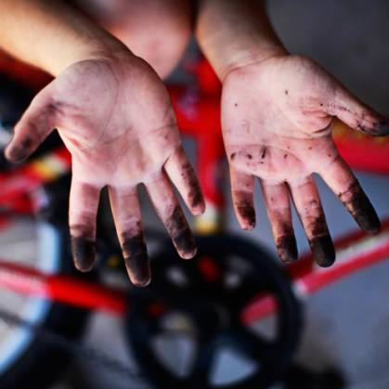
Promotional piece
Problem solution
Problem: greasy hands and legs from brushing past or handling bikes’ grease ejected from the pedals.
Solution: a pocket to place a pocket over the pedals to isolate the grease.

Slide 10
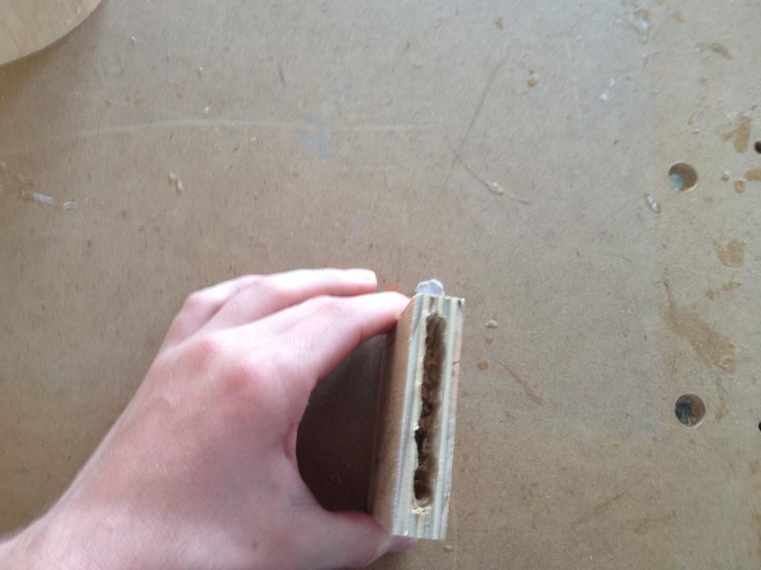
Promotional piece prototypes

Slide 11
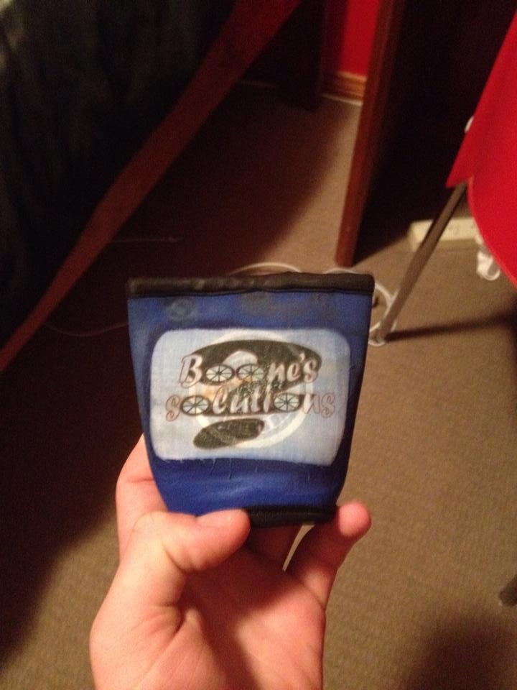
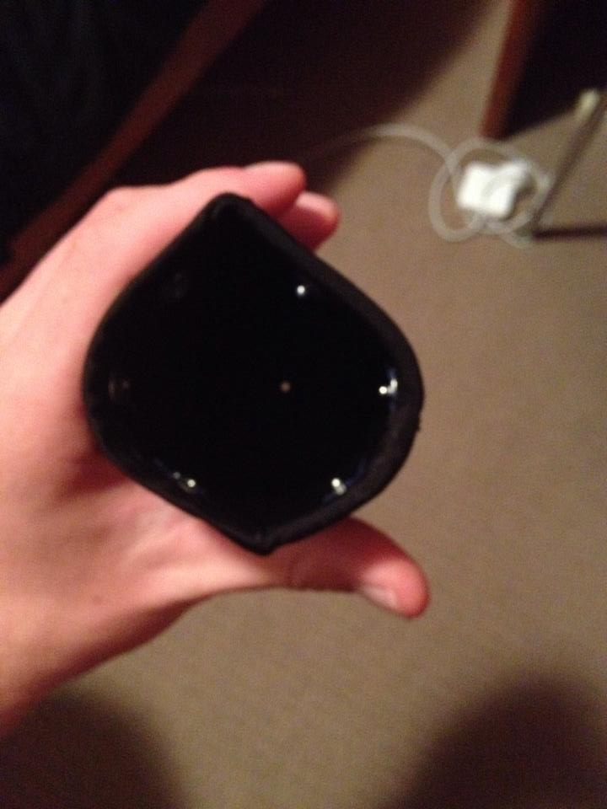
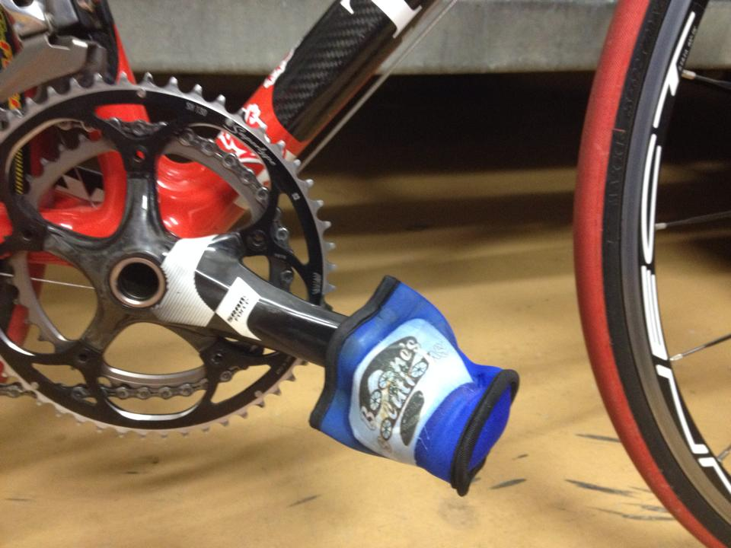
Promotional piece final

Slide 12
In conclusion
Boone Lennon was a great problem solver
He had a very rich sporting history
He has a philosophy of ‘problem solution’
He revolutionized each sport that he invented and found solutions in.
He has had great results in his inventions
I felt that this designer really reflected my thinking of design.

